Slide 1
Welcome to
Miss Messerschmidt, Mrs. Seastedt, and Mrs. Stokes
Notes:
‹#›

Slide 2
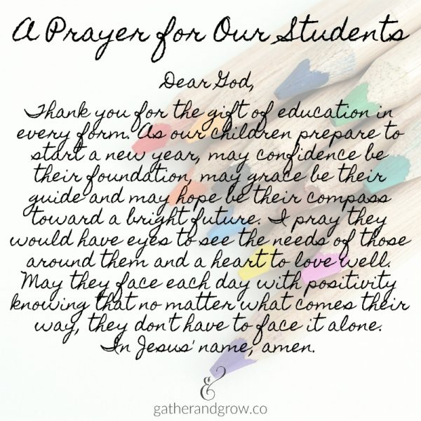
Welcome Prayer

Slide 3
Our Mission Statement
St. Pius X / St. Leo School is a diverse community forming students in the Catholic faith to excel in academics and service to others.
Notes:
‹#›

Slide 4
Theme for 2023 - 2024
Sharing our Gifts,
Rooted in Faith,
United in Spirit!

Slide 5
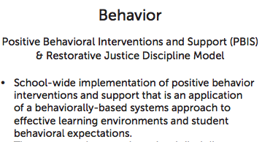
R.O.A.R!
R - Ready to Learn
O - Offer Respect
A - Achieve a Safe Environment
R - Responsible for Others and Ourselves
ROAR cards:
This year students may receive R.O.A.R. cards as an acknowledgement of positive behavior. The students may receive a ROAR card from any adult at SPSL. ROAR cards may be a collective acknowledgement of a class or an acknowledgement of an individual.

Slide 6
Celebrating R.O.A.R. Cards!
Notes:
‹#›

Slide 7
Curriculum Introduced this Year
Cursive Writing: Uppercase & Lowercase Letters
Practice proper formation of letters at home.
Multiplication: Multiplication facts through 11
Memorizing multiplication facts will be daily homework until all required facts are mastered (a minimum of 5 - 10 minutes per night).
Books:
Read two (on level) chapter books per semester. The students may choose the books but they must be approved by the teacher.

Slide 8
Consistent Communication between Home and School: Part 1
Weekly Updates
A weekly information will be posted on the SPSL website on the 3rd Grade Classrooms webpages. Each classroom has a separate webpage.

Slide 9
Consistent Communication between Home and School: Part 2
Daily Homework Folders and Friday Folders
*Please check your child’s backpack daily for any homework assignments/materials!
The “Homework” Folder will contain any paper homework/redo assignments and important notes to parents. The “Homework” Folder will come home DAILY (Monday - Friday).
The “Friday” Folder will come home on the last day of every week. It will contain corrected work and possibly notes for parents. PLEASE sit down and review your child’s work with him/her. This can be a wonderful bonding time as well as an opportunity to praise your child for his/her hard work. You will also see areas of study that require extra practice.

Slide 10
Working as Partners
to Benefit the Children
We look forward to working with you to help your child flourish in third grade! It is so important that your child complete all of the work sent home at night. This keeps him/her on track and prepared to continue learning. Ten minutes of homework per night per grade level is a standard expectation. As a 3rd grader, your child should spend 30 “quality” minutes of study time each day. When the work is completed, it should be promptly returned to the Homework Folder and backpack to eliminate the chance of leaving work behind (and stress in the morning)!

Slide 11
Homework
Complete Unfinished School Work
Redo/Fix Errors on Assignments
Memorize Math Facts
Study Spelling Words
Study for Tests/Quizzes
Practice Cursive Writing
Read, Read, Read
Work on Projects - Space Time Out for Bigger Projects
IXL
Book Reports

Slide 12
Assessments
Assessments:
STAR Testing in Reading & Math
(fall, winter, spring)
Results will be share with parents.
Math Fact Testing - addition & subtraction (fall, winter, and spring)
multiplication (winter and spring)
Results will be shared with parents.

Slide 13
Grading Scale
A+ = 100,99 A = 98,97,96,95 A- = 94,93
B+ = 92,91 B = 90,89 B- = 88,87
C+ = 86,85 C = 84,83,82,81,80,79 C- = 78,77
D+ = 76,75 D = 74,73,72 D- = 71,70
F = 69-0

Slide 14
What is Graded:
Daily Work (once concepts have been practiced)
Tests/Quizzes
Projects
Book Reports
* Assignments may be redone. Tests and quizzes MAY NOT be redone.
* If a paper has “DTIC” (Did Together in Class) written at the top of the page, this means the work was either completed together or corrected together.

Slide 15
Incomplete or Missing Work
Students will receive a late slip if their homework is not finished or not at school at the start of the school day in which it was due. Please sign the slip. Your child should return the signed late slip with the completed assignment the following day. If your child finishes the assignment by the end of the day, just the signed late slip must be returned.
If the assignment (finished or unfinished) is not at school at the beginning of the school day, the student will be given a copy of the work (if possible) along with a late slip. Your child should return the signed late slip with the completed assignment the following day.

Slide 16
Behavior
A warning will be given to students if they do not make a good choice with regard to behavior. If the behavior continues, a behavior slip will be given to the child to fill out. After three 3 slips have accumulated within a short period of time, a photocopy of the slips will be sent home for a parent’s signature. If the behavior becomes habitual, Mrs. Chattin and/or
Dr. Sepich will be notified.

Slide 17
Recess
Please help make sure your child is dressed for outdoor weather. As you know, Nebraska weather can greatly fluctuate throughout the day. An extra pair of socks in your child’s backpack on rainy or snowy days is always a good idea. Feel free to leave an old pair of shoes at school for outdoor activities.
Students may bring a toy(s) from home for recess. The toys must fit into the backpack. Nothing electronic may be brought. Students are responsible for any toys or other items brought to school.

Slide 18
Volunteers
If you would like to volunteer to work with students or help with field trips, please let us know!
We appreciate our volunteers!
Note: You must have attained or be willing to attain Safe Environment Certification.

Slide 19
Birthday Treat & Invitations
Students may bring a treat to school for their classmates to enjoy on or close to their birthdays. If your child has a summer birthday, we will celebrate his/her half birthday.
Please make sure the treats are peanut and tree nut free. Each individual teacher will let you know if there are any other types of allergies in their room. Please provide napkins or necessary utensils for the treat to make it quick and easy to serve at school.
Students will not be able to pass out invitations to birthday parties at school.

Slide 20
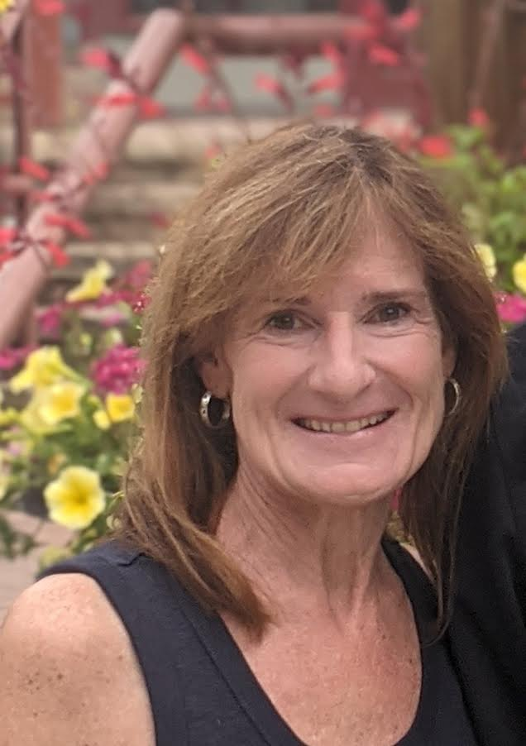
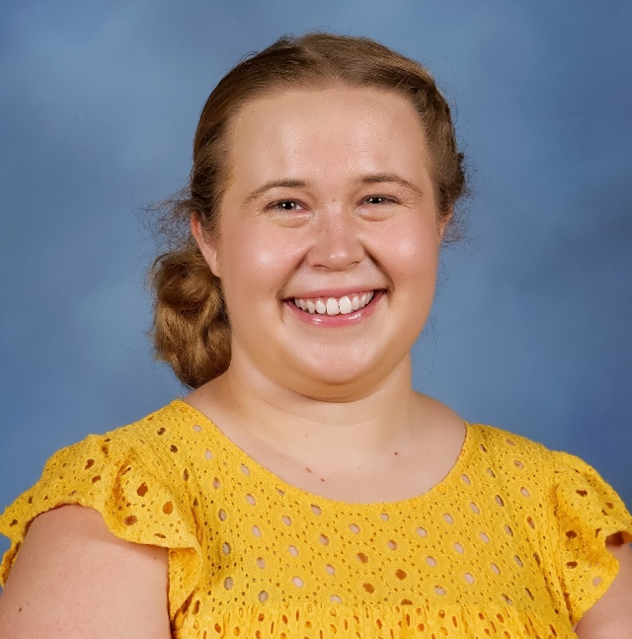
Mrs. Seasted
monica.seasted@spsl.net
Mrs. Stokes
mary.stokes@spsl.net
Miss Messerschmidt
katie.messerschmidt@spsl.net

Slide 21
Questions?
Please feel free to contact your child’s homeroom teacher with questions about 3th grade. Thank you for sharing your child with us this year.
Education is a shared commitment
between dedicated teachers,
motivated students, and enthusiastic
parents with high expectations.
-Bob Beauprez

